Slide 1
HPCM Logs in Grafana Loki and VictoriaLogs for Observability
byby
Amogh Bhat N
Karthik P K
Karthik Prabhu
Karthik S Salian
Yashas Hegde
Under the Guidance of:
Ambresh Gupta

Slide 2
Agenda
Overview of Pipeline Architecture
Overview of Loki
Loki Working
Working of VictoriaLogs
Comparison between Loki, VictoriaLogs and Opensearch

Slide 3
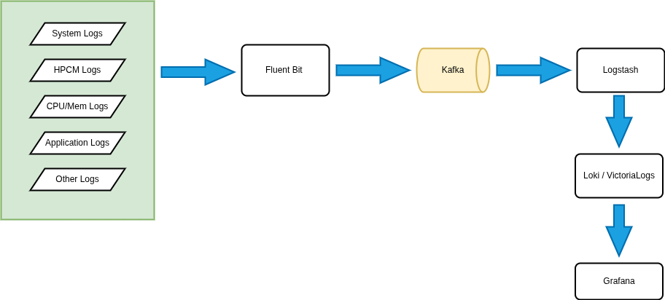
Architecture

Slide 4
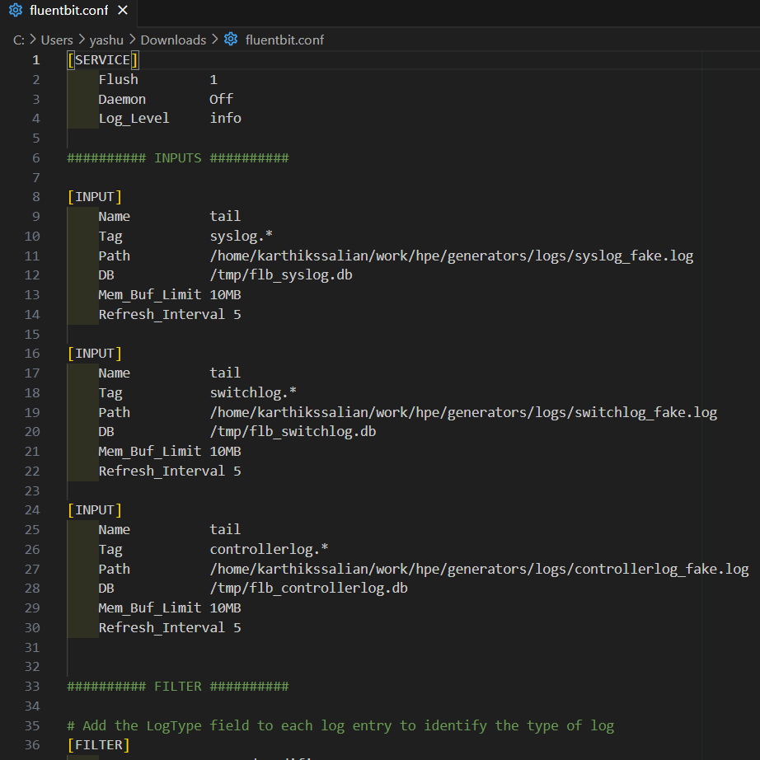
Overview of Pipeline - Fluent Bit
A high-performance tool for collecting, filtering, and forwarding logs with minimal resource usage.
Efficient, scalable, and integrates seamlessly with Kafka, Loki, and OpenSearch for log management
Configured Fluent Bit to collect logs from the needed location
Logs are sent to Kafka for further processing

Slide 5
Apache Kafka
A distributed messaging system for real-time data streaming and event-driven architectures
It provides high scalability, fault tolerance, and reliable message delivery for large-scale data processing.
Logs from Fluent Bit are ingested into Kafka for decoupled, scalable processing

Slide 6
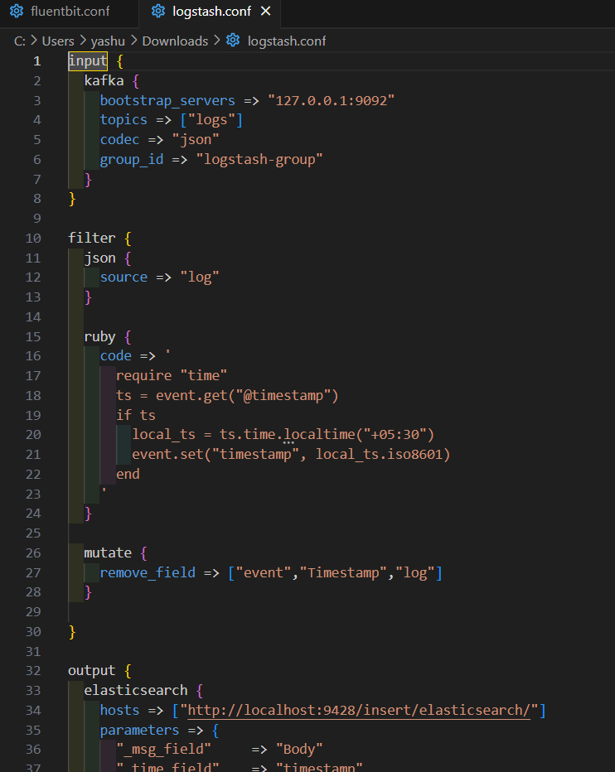
3. Logstash - Log Transformation & Routing
A server-side data processing pipeline that ingests, transforms, and forwards logs
It supports powerful data transformation, integrates with various outputs, and ensures structured log processing
Configured Logstash to consume logs from Kafka topics
Logs are forwarded to Loki/VictoriaLogs for real-time analysis

Slide 7
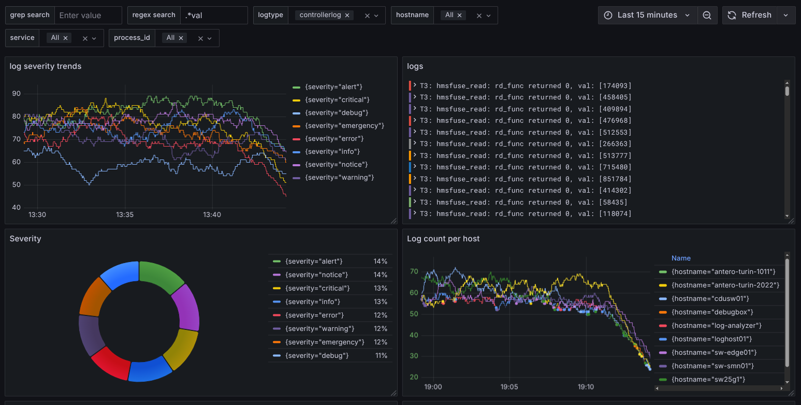
Grafana Dashboard
Grafana Dashboard provides powerful, real-time visualization of logs, metrics, and traces.
It supports integrations with OpenSearch, Loki,VictoriaLogs, and more for unified observability.
Grafana Dashboard with Loki as Datasource

Slide 8
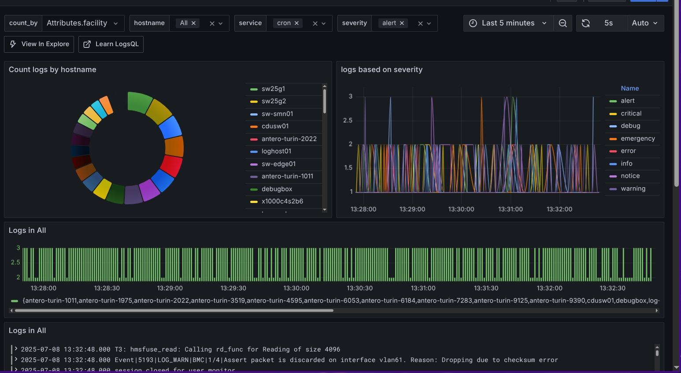
Grafana Dashboard
With VictoriaLogs as a datasource in Grafana Dashboard only the logstash configuration file is changed
Grafana Dashboard with VictoriaLogs as Datasource

Slide 9
Grafana Loki
Grafana Loki is a cutting-edge, cloud-native log aggregation system engineered for scalability, efficiency, and cost savings. It enables robust observability at scale, seamlessly integrating with Grafana for enhanced monitoring and visualization.
Introduced by Grafana Labs in December 2018.
Open-source and horizontally scalable
Label-based indexing (metadata-only) ensures efficient storage
Fully compatible with Prometheus monitoring workflows
Perfectly suited for cloud-native, multi-tenant, and Kubernetes environments

Slide 10
Core Components
Component | Role
Distributor | Validates and routes logs via consistent hashing
Ingester | Temporarily buffers logs and writes to storage
Querier | Retrieves log data from ingesters and storage
Query Frontend | Load-balances and parallelizes queries
Ruler | Evaluates and triggers alerting rules
Compactor | Deduplicates and compresses stored log chunks

Slide 11
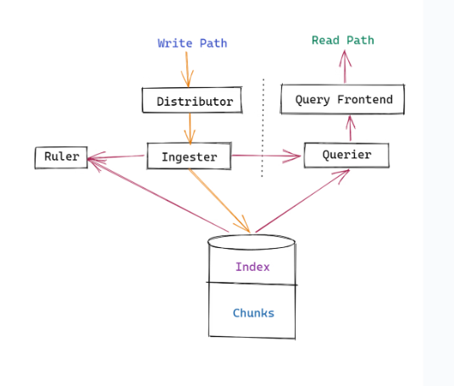
Write and Ingest Path
Log Collection – Logs are gathered via Fluent Bit, or Logstash
Distribution – The Distributor ensures validated, load-balanced routing
Ingestion – Logs are ingested in-memory, chunked, and persisted to object storage
Replication & Quorum – High availability through replicated ingestion and write acknowledgment

Slide 12
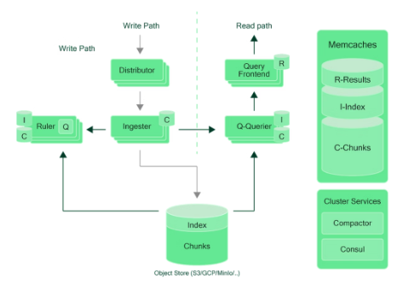
Read Path & Query Optimization
LogQL Query Initiated – The user sends a query to the Query Frontend.
Query Decomposition – The query is broken down into parallelizable subtasks for efficiency.
Execution – The Querier retrieves data from ingesters and persistent storage.
Aggregation – Results are deduplicated and combined for accuracy.
Response – Final data is delivered to the client or dashboard within milliseconds.

Slide 13
Deployment Modes
Mode | Description | Scale | Complexity | Use Case
Monolithic | All components in a single binary | ~20GB/day | Low | Dev/test environments
Simple Scalable | Components split into read/write/backend | TBs/day | Moderate | Mid-size clusters
Microservices | independent services for each component | 100s TBs/day | High | Enterprise-grade production

Slide 14
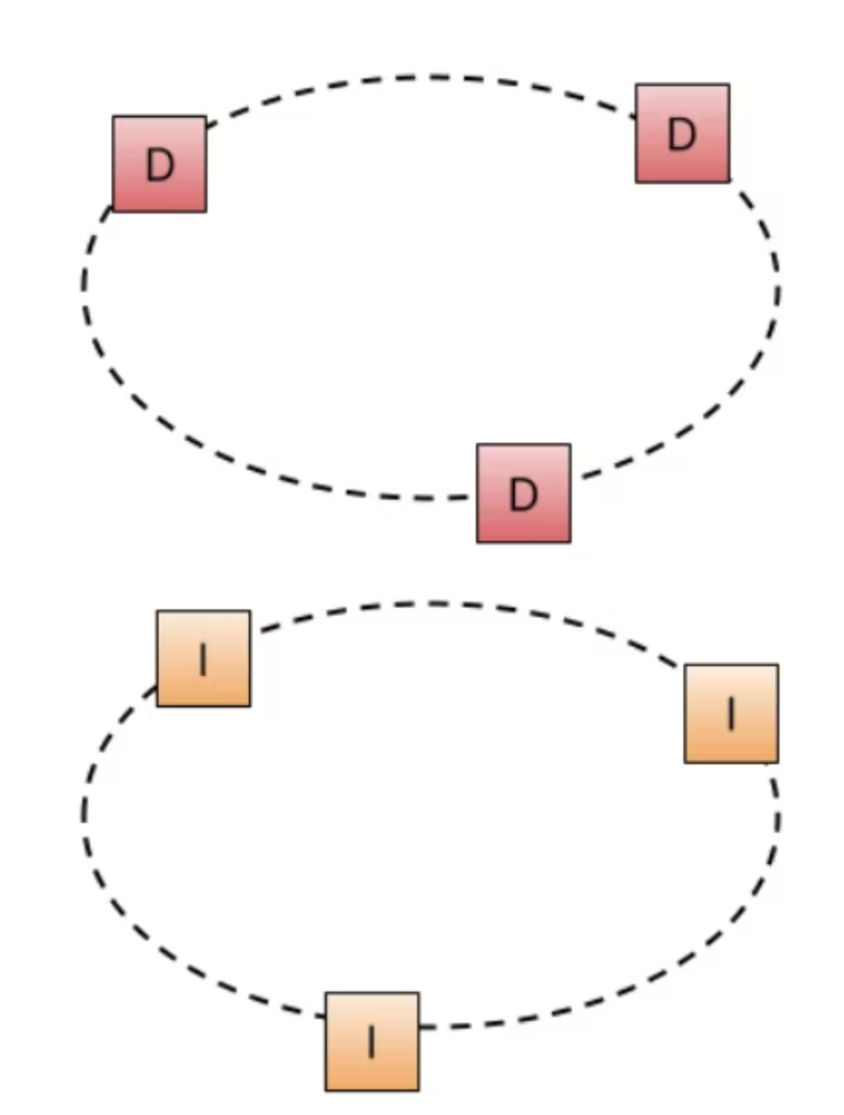
Loki Hash Ring Architecture
Loki uses a hash ring to manage how logs are spread across different servers. Each server gets a spot on the ring, and incoming logs are sent to the right server based on their labels.This helps Loki handle more data easily, stay reliable, and balance the load across all servers.
Dynamic Membership enables seamless node addition and removal in real time
Consistent Hashing guarantees even distribution of logs across nodes
Fault Tolerance achieved through automatic reassignment and replication of logs
Backpressure & Batching techniques maintain ingestion stability under heavy load
Horizontal Scalability by simply adding more ingester nodes

Slide 15
Multi-Tenant Management and Security
Tenant Isolation via X-Scope-OrgID Header
Feature | Benefit
Label-based isolation | Full separation of logs between tenants
Per-tenant quotas | Control ingestion, storage, and query load
Role-based access | Teams see only their own logs
API-based header injection | Enables custom access workflows
Reverse proxy or Grafana Enterprise | For secure, scalable, dynamic tenant handling

Slide 16
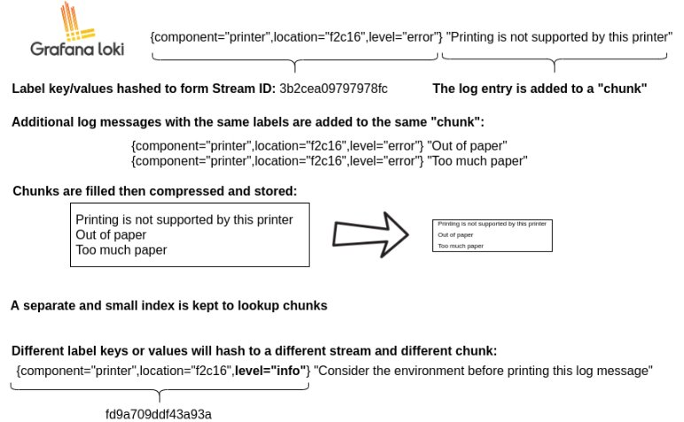
Loki Storage
Loki stores all data in a single object storage backend​
Eg: Amazon S3, Google Cloud Storage, Microsoft Azure Blob, IBM COS, Baidu OS, Alibaba OSS
Uses an adapter called index shipper (or shipper)​
Loki compresses chunk data before writing it to storage
it indexes only the label so it uses significantly less storage than systems like OpenSearch
The index is a table of contents of where to find logs for a specific set of labels.​
The chunk is a container for log entries for a specific set of labels.

Slide 17
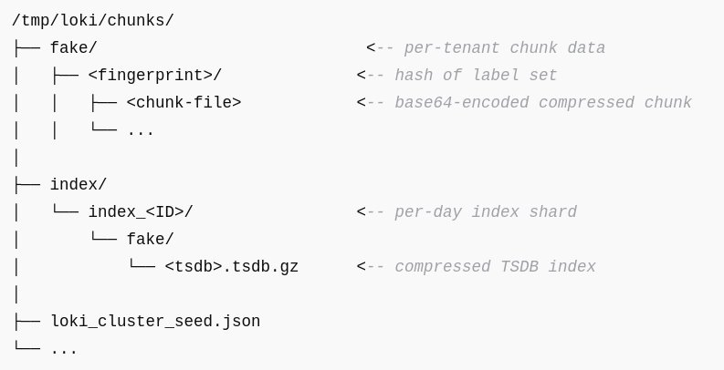
File System Storage
/chunks/fake/<fingerprint>/
Raw compressed logs
Each file is a chunk for a unique log stream (based on labels) ​
<fingerprint> is a hash of the label set
Chunk filenames are base64-encoded and represent a time-bounded segment
/chunks/index/index_<ID>/fake/*.tsdb.gz
Daily index shards
Each shard maps fingerprints to chunk metadata
Helps Loki quickly locate log chunks based on time range and label queries
fake is a default tenant it automatically gives name if no X-Scope-OrgID header is added

Slide 18
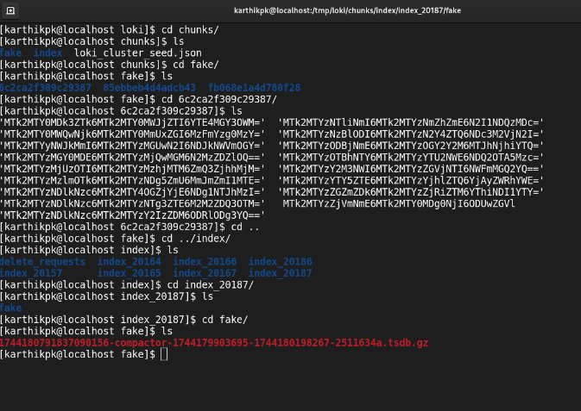
How Logs are Queried
Loki hashes label query to compute the corresponding fingerprint
It searches index shards (*.tsdb.gz) for matching entries
Retrieves a list of chunks associated with the fingerprint and time range
Loads the chunk files from /chunks/fake/<fingerprint>/
Decompresses the data and returns matching log lines to Grafana or LogCLI

Slide 19
VictoriaLogs
VictoriaLogs is a high-performance, cost-efficient, and horizontally scalable log database designed for fast ingestion, real-time querying, and long-term retention. Developed by VictoriaMetrics in 2022, it brings royalty-class logging performance to modern observability stacks.
Open-source and horizontally scalable
Designed for high-throughput log ingestion
Optimized storage format with blazing-fast reads
Compatible with Grafana, Prometheus-style remote-write and logging agents

Slide 20
VictoriaLogs System Overview
Component | Function
Log Agents | Fluent Bit / Logstash / Vector collect logs and forward them via HTTP
VictoriaLogs Node | Receives logs, indexes them, and writes to compressed storage
Query Engine | Provides fast read-access through advanced filters and full-text search
Storage Engine | Optimized for write-heavy workloads, low-latency access, and disk efficiency
Access Layer | Supports API key control and tenant-level access management

Slide 21
Write and Ingest Path
Collection - Logs are collected using agents like Fluent Bit or Vector and sent via HTTP.
Ingestion - VictoriaLogs immediately parses and stores logs using columnar compression.
Indexing - Structured data and full-text are indexed on the fly for rapid future queries.
Retention - Log retention policies can be tuned with time-based deletion or disk quotas.
Query Path and Search Capabilities
Supports powerful Lucene-like query syntax.
Enables real-time filtering, full-text, and regex search over billions of logs.
Field-based queries allow fast aggregation, diagnostics, and debugging.
Returns results in milliseconds even under heavy load.

Slide 22
Deployment Modes
Mode | Description | Best For
Single Binary | All-in-one instance with ingestion + query | Dev/Test, Small Systems
Clustered Mode | Horizontally scalable, shared object storage | Mid to Large Deployments
HA Production | Multi-node with replication, sharding, and HA | Enterprise + SaaS Scale

Slide 23
Access Control Features
Feature | Advantage
API Key Isolation | Each tenant logs to a separate namespace using unique tokens. Ensures data isolation and secure multi-tenant access.
RBAC + Path Separation | Role-Based Access Control with path-based isolation allows different teams to access only their relevant data.
SSO / OAuth Support | Plug-and-play identity integration enables secure enterprise access using Single Sign-On (SSO) or OAuth providers
Query Limits | Prevents system overload by enforcing per-user query caps, ensuring performance and fair resource distribution.

Slide 24
Overall Comparisons
Aspect | Grafana Loki | VictoriaLogs | OpenSearch
Indexing | Label-based (metadata) | Full-text + field-based indexing | Full-text (resource-heavy)
Query Language | LogQL (PromQL-like) | LogSQL (SQL-like, log-optimized) | Lucene/DSL-like
Storage | S3 + compressed chunks | Local/shared disk with compression | Local disks
Ingestion | High throughput, metadata-optimized | Ultra-high, content-aware ingestion | Good (requires tuning)
Search Speed | Slower for full-text | Millisecond search on TBs | Fast, high-resource
Scalability | Lightweight, Kubernetes-native | Simple binary or cluster | complex setup with sharding & replication

Slide 25
Conclusion
All open-source logging solutions — Opensearch, Loki, and VictoriaLogs — offer unique strengths and trade-offs.
Loki provides label-based indexing and tight integration with Grafana, making it simple to use and manage for structured log analysis.
VictoriaLogs is optimized for high-ingestion workloads with low storage overhead and extremely fast query performance.
OpenSearch supports powerful full-text search, complex filtering, and advanced analytics, ideal for deep log investigations.
System performance, resource usage, and query response times vary across tools and should be benchmarked under real workloads.
No one-size-fits-all solution exists—the best choice depends on ingestion rate, query complexity, retention needs, and infrastructure.

Slide 26
Thank you

